Slide 1
RNN Stock Price Prediction
Logan Roach & Brandon Liunoras
Youtube Link: https://youtu.be/H23-HsCyiW0
Notes:
Introduction: RNN Stock Prediction

Slide 2
Agenda
Question to Answer
Stock Data Demonstration
Simple Neural Network
Random Forest
Long Short Term Memory
Gated Recurrent Unit
Analyze Results
Final Conclusion
Recommendations and Considerations
Notes:
Questions to Answer
Stock Data Demonstration
Base
Random Forest
LSTM 2
GRU 3
Analyze Results
Final Conclusion
Recommendations and Considerations

Slide 3
Question to Answer
Can a RNN Model predict stock price and outperform traditional models?
Notes:
Can a RNN Model predict stock price and outperform traditional models?

Slide 4
The Models
Traditional:
Random Forest Classifier
Simple Neural Network
RNN:
Long Short-Term Memory (LSTM)
Gated Recurrent Unit (GRU)
Notes:
Identifying which models that will be used

Slide 5
Stock Demonstration
Acquiring the Data (Yahoo Finance)
Utilizing Custom Python Module
The Data:
Top 10 Stocks in 10 different business sectors
Running the data through each model
Analyzing Results with Accuracy Percentage or MAE
Using Apple Stock for Demo
Notes:
Acquiring the Data (Yahoo Finance)
Utilizing Custom Python Module
The Data:
Top 10 Stocks in 10 different business sectors
Running the data through each model
For analyzing the results we’re using Accuracy Percentage for the Random Forest Model or (Mean Absolute Error) for the Other MODELs
Using Apple Stock for Demo

Slide 6
Quick Question…
?
What is MAE?
Notes:
What is MAE or Mean Absolute Error

Slide 7
MAE Explained
Mean Absolute Error:
Measure of errors between paired observations expressing the same phenomenon
Lower MAE is Better!
MAE is relative depending on the data itself
MAE here shows how many dollars away the predicted value is from the true value
Notes:
Mean Absolute Error
MAE measures the average magnitude of errors between predictions and actual values, and it's particularly useful when you want to know how far off, on average, your RNN model's predictions are from the true values. Lower MAE values indicate better performance, as they mean the model's predictions are closer to the actual values.

Slide 8
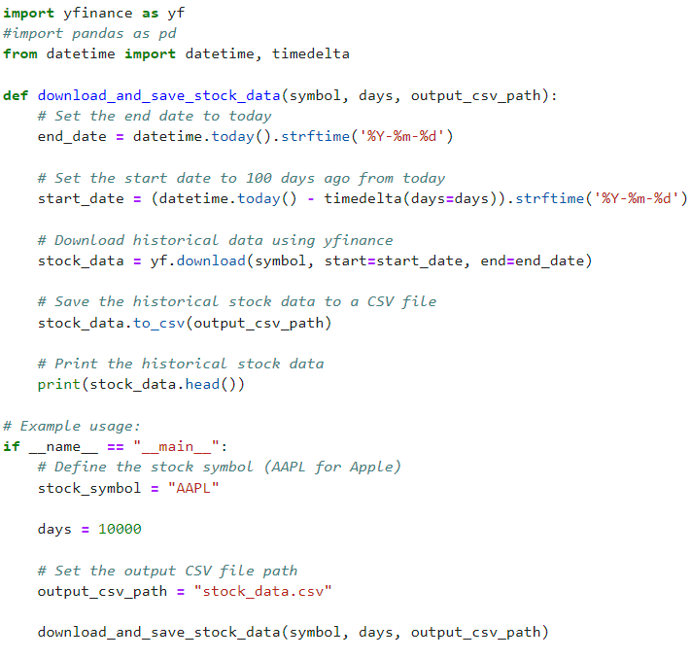
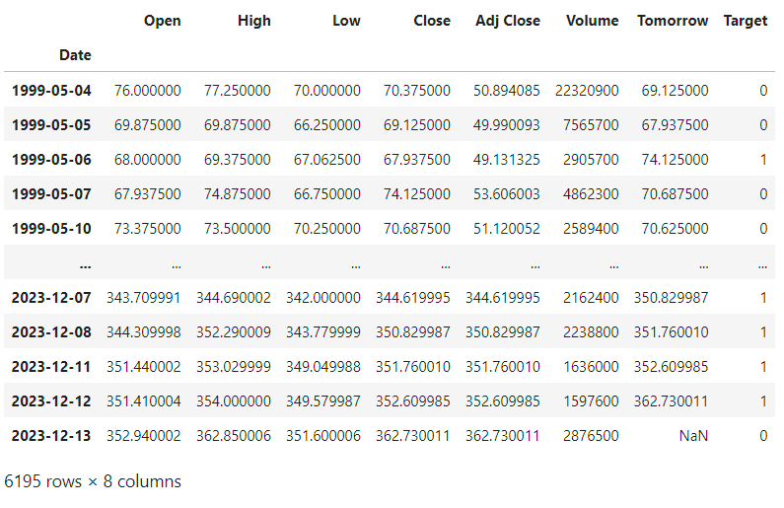
Data Acquisition Module
Notes:
This is how we got the stock data to run through our model. yfinance was crucial as it is free and gave us unlimited API calls. The only downside is the data is limited to daily stock information.
The function we created here was essential a quality of life addition to the project so we could just adjust the stock price ticker and the number of days and easily pull the information needed.
The function works by taking the stock ticker (from the yfinance stock tickers), the length of time we want to cover (# of days), and creates a csv for the data to be stored and accessed later for passing through the models.

Slide 9
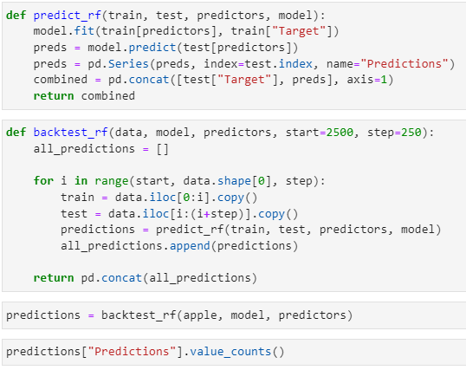
Random Forest
Used as an alternative to machine learning
Simple baseline to see if machine learning is better.
Notes:
Random Forest model- an ensemble learning method that combines the predictions of multiple decision trees to make more accurate and robust predictions. It is used for both classification and regression tasks.
Here we are using it as an alternative to machine learning and as a simple baseline to see if machine learning is better.
If the Random Forest model works then theres no need to use the machine learning approach.

Slide 10
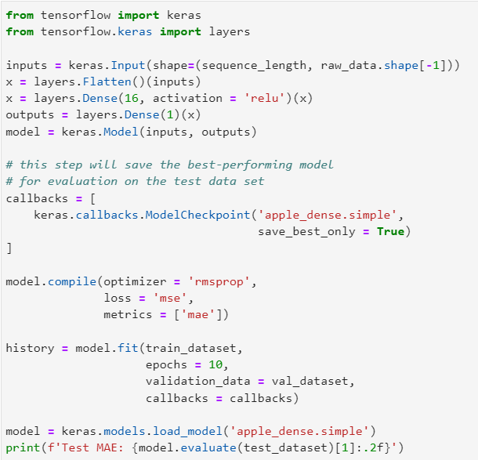
Simple Model
Uses Relu
16 Dense Layers
Can be tweaked and use different types of activations
Notes:
For our base model we are essentially trying to see if if we can use the previous days price to predict the next days price. We went with this approach as the base model because it’s the simplest baseline we can create, and a lot of financial market sentiment can be based on the previous day’s performance. A simple idea can go a long way and if it works well then there’s no need to go further.
Here the model uses a simple relu activation and 16 layers after flattening our input with only 10 epochs. The model could be improved by adding more layers, epochs or adjusting the learning rate but for a simple model we thought this was sufficient.
Throw it over to Brandon

Slide 11
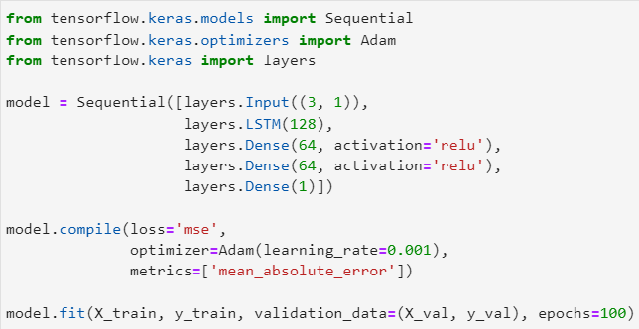
LSTM
Classic LSTM
Complex Architecture
No Attention
3 Gates of Info Flow
Utilizes 128x64x64
3 Input
1 Output
Notes:
Classic LSTM
No Attention
Utilizes 128x64x64
3 Input
1 Output
LSTM has a more complex architecture compared to GRU. It consists of three gates: the input gate, the forget gate, and the output gate.
LSTM typically has more parameters to learn, which may require more data and computational resources.
The choice between LSTM and GRU often depends on the specific task and dataset. In practice, there is no clear winner, and performance can vary based on the problem

Slide 12
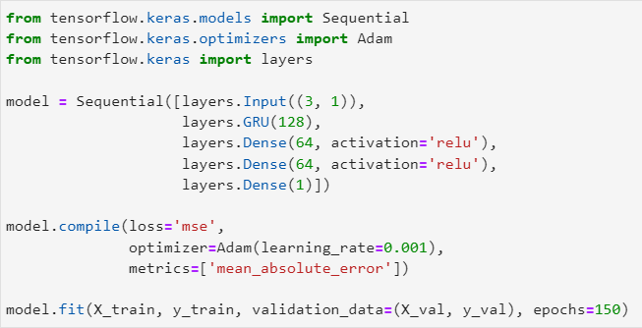
GRU
Gated Recurrent
Simpler Architecture than LSTM
More Efficient
2 Gates of Info Flow
Utilizes 128x64x64
3 Input
1 Output
Notes:
Gated Recurrent
Simpler but more efficient than LSTM
Utilizes 128x64x64
3 Input
1 Output
GRU is a simplified version of LSTM and has two gates: the update gate and the reset gate.
GRU has fewer parameters compared to LSTM because of its simplified structure. This can make GRU models faster to train and require fewer data to generalize effectively.
Again,. In practice, there is no clear winner, and performance can vary based on the problem

Slide 13
Accuracies Table
Stock (Ticker) | Random Forest (%) | Simple (MAE) | LSTM (MAE) | GRU (MAE)
Apple (AAPL) | 0.531 or 53.1% | 9.32 | 3.492 | 5.4868
Sherwin Williams (SHW) | 0.516 or 51.6% | 16.62 | 3.308 | 4.3750
UPS (UPS) | 0.513 or 51.3% | 36.08 | 5.943 | 2.8692
Duke Energy (DUK) | 0.533 or 53.3% | 50.60 | 0.889 | 0.8377
Unitedhealth Group (UNH) | 0.54 or 54% | 54.79 | 4.508 | 0.8260

Slide 14
Accuracies Table Continued
Stock (Ticker) | Random Forest (%) | Simple (MAE) | LSTM (MAE) | GRU (MAE)
Amazon (AMZN) | 0.528 or 52.8% | 69.18 | 2.483 | 0.8264
Coca-Cola (KO) | 0.525 or 52.5% | 27.33 | 0.376 | 0.3902
Alphabet Inc Class A (GOOGL) | 0.521 or 52.1% | 14.17 | 1.937 | 1.8761
American Tower (AMT) | 0.518 or 51.8% | 53.56 | 4.173 | 8.9885
Goldman Sachs (GS) | 0.513 or 51.3% | 143.88 | 3.691 | 3.5851

Slide 15
Analyzing Results
!
Ranking of the Models
Notes:
Looking into the results of the model we can see a few things:

Slide 16
Model Ranking
GRU - 3.0061 Average MAE
LSTM - 3.08 Average MAE
Simple Model - 47.553 MAE
Random Forest - 52.4% Average Accuracy
Does this make GRU the best?
Notes:
Our RNN models are better than a Random Forest or a Standard Neural Network,
Essentially, the Random Forest was a coin flip in terms of accuracy, while our models are reasonably close to the true values
For the Base model: the model's predictions tend to deviate from the true stock prices by an average of $47.55
For the LSTM model: the model's predictions tend to deviate from the true stock prices by an average of $3.08
For the GRU model: the model's predictions tend to deviate from the true stock prices by an average of $3.01
GRU just barely outperform he LSTM model but there was no clear winner

Slide 17
Overall Final Thoughts
GRU and LSTM outperform basic models
GRU and LSTM can give fair predictions, however:
They should not be used as a guaranteed stock predictor
The complex and dynamic nature of financial markets requires a combination of external factors that influence stock price
Notes:
GRU and LSTM outperform basic models
GRU and LSTM can give fair predictions, however:
They should not be used as a guaranteed stock predictor
The complex and dynamic nature of financial markets requires a combination of external factors that influence stock price
Other considerations include: risk management, the potential impact of prediction errors on your investment decisions, along with the overall performance of the model
We would absolutely not use this for complex financial trading such as option trading

Slide 18
Other Considerations
In Simple Model:
Different Activations Used
Sigmoid yielded similar results: 36.08 MAE
Lots of Pitfalls/Complications
Technical Issues
Ensuring that all programs cooperate
Data Issues
Overfitting
Notes:
The Base model’s performance was poor, even when changing the the activation function the results were poor. Would not recommend using the model without optimization or improvement.
Complications we faced included gathering scaping the data and then processing the data so it could be fed into the model. Initially there was some overfitting issues but we think it was an artifact of how we initially processed the data however the experience made us recognize the issue and conscious of that issue when improving the model.
Now Back to Brandon

Slide 19
Building the Price Predictor
Displays price predictions against actual close stock prices.
Utilizes prior data to reach a target.
DISCLAIMER: Does NOT forecast for future days

Slide 20
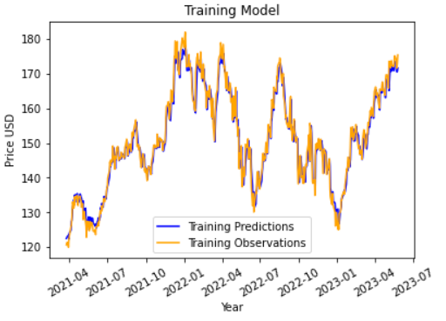
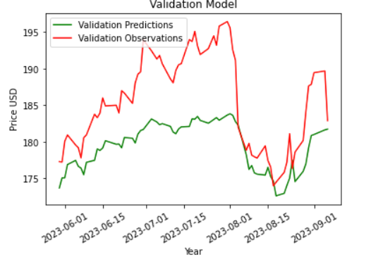
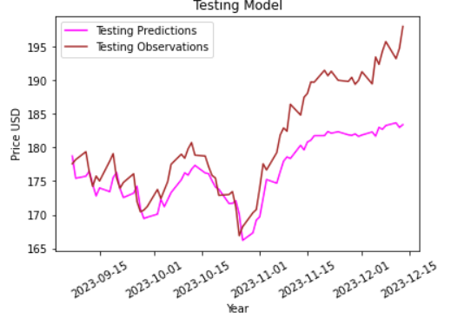
Building the Price Predictor

Slide 21
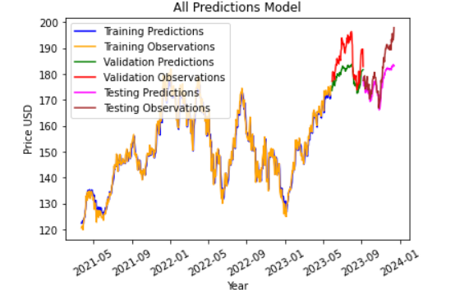
Building the Price Predictor

Slide 22
RNN Stock Prediction
Thank You!

